Slide 1

A
Mini Project - II Presentation on
“Online Chatbot based Ticketing System”
Presented by
Mr. Shriyash Amarnath Patil
Mr. Tanmay Dinesh Nagawade
Mr. Narendra Nanasaheb Khamkar
Ms. Vaishnavi Santosh Gopale
Mr. Suraj Ramdas Pansare
Under the guidance of
Dr. Sofiya Mujawar
Department of Information Technology
School of Engineering & Technology
D.Y. Patil University, Pune.
Academic Year 2024-25.

Slide 2
Presentation Outline
Introduction
Literature Survey
Methodology(Hardware & Software)
Schematic
Flowchart /Algorithm
Simulation Results (if any)
Applications
Conclusions
References

Slide 3
Introduction
The project aims to design and develop an intelligent ticketing system using a chatbot interface. The system will be capable of understanding user queries, providing information, and automating ticketing processes

Slide 4
Introduction (Cont’d…..)
1
Need for Automation
Traditional ticketing systems often involve manual processes, which can be time-consuming and prone to errors.
2
Enhanced User Experience
A chatbot interface can provide a more user-friendly experience, allowing customers to access ticketing services easily.
3
Real-time Support
The chatbot can provide instant support to users, addressing inquiries and resolving issues in real-time.

Slide 5
Literature Survey
S.No | Paper Title & Authors | Methodology | Key Contributions | Limitations | Year
1. | Keystroke- Level Model to Evaluate Chatbot Interface for Reservation System | Literature review of chatbot architectures for customer support. Comparison of frameworks like Dialog flow and Rasa. | Provides a high-level overview of chatbot architecture for automating ticket creation and management in customer support systems. | Lacks detailed implementation and real-world application data. | 2019
2. | Leveraging AI Chatbots for IT Help Desk Automation: A Case Study | AI-driven chatbot implementation for automating help desk functions, including ticket generation and query resolution. | Demonstrates the use of NLP for classifying and routing support tickets, improving efficiency in ticket handling. | No focus on the chatbot interface or user interaction model. Limited to ticket classification. | 2019
3. | Design and development of ticket booking system using smart bot | The main use of the chatbot on the website is to respond to the user’s queries. For instance, the chatbot in messenger, and telegram bot. it is going to take text as input. once the chatbot receives the user’s request it is going to match the keywords and responds as per the request. | Provides a complete framework from chatbot design to deployment, with a focus on real-time ticket handling. | Primarily focused on architecture without extensive performance benchmarks. | 2022

Slide 6
S.No | Paper Title & Authors | Methodology | Key Contributions | Limitations | Year
4. | Proposing Tourism Chatbot by employing the wisdom of crowds in building its knowledge base | The methodology used in this study was quantitative with the main activity was by conducting online questionnaires with closed-ended questions. The sampling method was non probabilistic with n=40 in the initial attempt | Detailed insights on how chatbots can improve efficiency in ticket handling and customer interaction processes. | Based on a single case study, so generalizability to other industries may be limited. | 2022
5. | Enhanced Opened and distance learning using AI-Powered chatbot a conceptual framework | The proposed system will make use of bot Rule-based chatbots, AI Chatbots and Multinomial Naive Bayes algorithm. The rule-based bot completes scripted actions based on keywords and guided by a decision tree, a list of predefined options leading to the desired response are provided to the learner | Proposes AI chatbot solutions that reduce human intervention in help desk ticketing systems and automate ticket lifecycle processes. | Focuses on IT-specific help desk automation without generalization to other support systems. | 2022
6. | Intelligent Agent based Ticket Booking System | This section discusses about the methodology used in developing the proposed system. The methodology chosen is further elaborated regarding the way to implement this project. | Highlights user experience challenges in using chatbots for IT ticketing and suggests improvements for user satisfaction. | Limited scope of chatbot functions—focused mainly on usability rather than full integration with ticketing systems. | 2024

Slide 7
Methodology
Hardware :-
Windows 10/11, i3/i5 Core Processor, Internet
Software:-
VSCode, MYSQL, Browser.
Technologies:-
HTML, CSS, Javascript, Python, Machine Learning, MYSQL.

Slide 8
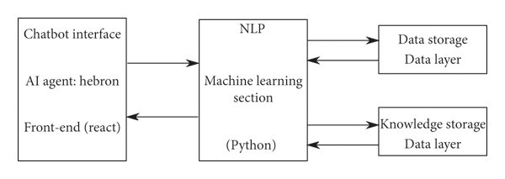
Block Diagram
(Html, CSS)

Slide 9
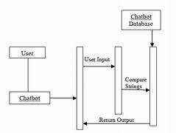
Schematic -

Slide 10
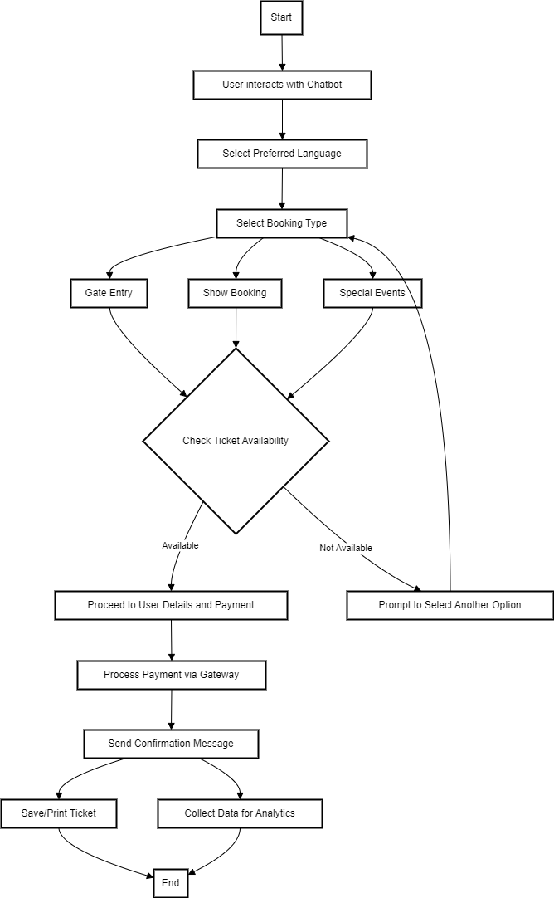


Flowchart / Algorithm

Slide 11
Applications
1
Event Ticketing
2
Travel Booking
Streamline the purchase of tickets for concerts, sporting events, and other entertainment.
Seamlessly reserve flights, hotels, and rental cars through an intuitive chat interface.
3
Public Transportation
4
Customer Service
Easily purchase and manage public transportation tickets, from subway to buses.
Provide instant and personalized support to customers, resolving issues quickly.

Slide 12
Conclusion
1
2
3
4
Efficiency
Personalization
Accessibility
Cost Savings
Chatbot-based ticketing systems simplify ticket purchase and management, saving time and effort.
Tailored recommendations based on user preferences and past purchases enhance the experience.
Easy-to-use chat interfaces are accessible to a wide range of users, regardless of technical skills.
Automation reduces operational costs for ticketing organizations, improving profitability.

Slide 13
References
[1] Smirnov, A. Kashevnik, N. Shilov, N. Teslya and A. Shabaev(2014), Mobile application for guiding tourist activities: tourist assistant - TAIS, Proceedings of 16th Conference of Open Innovations Association FRUCT, Oulu, Finland, doi: 10.1109/FRUCT.2014.7000931
[2] U. Shanmugam, S. Mani, S. Sivakumar and P. Rajeswari, "Human-
Computer text conversation through NLP in Tamil using Intent
Recognition," 2019 International Conference on Vision Towards
Emerging Trends in Communication and Networking (ViTECoN),
Vellore, India, 2019, pp. 1-5, doi: 10.1109/ViTECoN.2019.8899571.
[3] J. D. Preece and J. M. Easton, Blockchain Technology as a
Mechanism for Digital Railway Ticketing, IEEE International
Conference on Big Data (Big Data), Los Angeles, CA, USA, 2019
doi: 10.1109/BigData47090.2019.9006293.
[4] E. Handoyo, M. Arfan, Y. A. A. Soetrisno, M. Somantri, A. Sofwan
and E. W. Sinuraya, "Ticketing Chatbot Service using Serverless
NLP Technology," 2018 5th International Conference on
Information Technology, Computer, and Electrical Engineering
(ICITACEE), Semarang, Indonesia, 2018, pp. 325-330, doi:
10.1109/ICITACEE.2018.8576921.

Slide 14
[5] Xiao Yu. (2021), Design of Aerospace QR Ticketing System Based
on Mobile Devices,4th International Conference on Information
Systems and Computer Aided Education (ICISCAE 2021).
Association for Computing Machinery, 2021.https://dl.acm.org/doi/10.1145/3482632.3484146
[6] Abhay Tiwari and Ashima Mehta(2023), Flight Reservation
System,International Journal of Advanced Research in Science,
Communication and Technology (IJARSCT), ,DOI: 10.48175/IJARSCT-9152.
[7] Sai Chaithanya Gandhi.P,Sreenivasulu.G(2022), Flight Reservation
System, International Journal of Creative Research
Thoughts(IJCRT), Volume 10, Issue 6 June 2022 | ISSN: 2320-2882.
[8] Majduddeen Al Jalaliya P.P, Dr. Gajraj Singh Ahirwar(2018), A
Study of E-Ticketing System and Its Value in Indian Railways,
International Journal of Advance Research and Innovative Ideas in
Education, IJARIIE-ISSN(O)-2395-4396

Slide 15
Thank you!

